Slide 1

Library Management Database
Introduction to Database Management using SQL
Arnav Mallick
M2022BSASS005

Slide 2

Requirements
Each book must have a Unique ID number
Members of the library can search for books by title, author, category and publication year
There can be more than one copy of a book owned by the library
Members can borrow books, and the system should store the date of borrowing
Library staff can see who has borrowed a particular book, when members have joined and activity status of a member
Members can reserve copies of a book to loan later, if all copies are loaned already
Fines can be imposed upon members if loaned books are not returned within a stipulated time. The fine amount depends on the number of days the borrowed book is overdue

Slide 3
Tables
Table Name | Primary Key | Attributes | Foreign Keys (Referenced Table) | Related Tables | Description
category | id | category_name (UNIQUE) | None | book | Stores book categories.
author | id | first_name, last_name (NULL allowed) | None | book | Stores author details. Dependent on book.
book | id | title, publication_year (CHECK >= 1500), copies_owned (CHECK >= 1) | author_id (author), category_id (category) | author, category, loan, reservation | Stores book details.
member_status | id | status_value (UNIQUE) | None | member | Stores member status (e.g., active, inactive).
member | id | first_name, last_name (NULL allowed), joined_date (CHECK >= 2000-01-01), active_status_id | active_status_id (member_status) | loan, fine, fine_payment, reservation | Stores library members.
loan | id | loan_date, returned_date (CHECK loan_date <= returned_date) | book_id (book), member_id (member) | book, member, fine | Stores information about book loans.
fine | id | fine_date, fine_amount (CHECK >= 0) | member_id (member), loan_id (loan) | member, loan, fine_payment | Stores fines issued to members for late returns.
fine_payment | id | payment_date, payment_amount (CHECK >= 0) | member_id (member) | member, fine | Stores fine payments made by members.
reservation_status | id | status_value (UNIQUE) | None | reservation | Stores reservation statuses (e.g., pending, fulfilled, cancelled).
reservation | id | reservation_date | book_id (book), member_id (member), status_id (reservation_status) | book, member, reservation_status | Stores book reservations made by members.

Slide 4
Relations
Entity 1 | Entity 2 | Relationship Name | Type | Primary Key in Entity 1 | Foreign Key in Entity 2 | Referenced Table
category | book | Categorises | One-to-Many | id | category_id | category
author | book | Writes | One-to-Many | id | author_id | author
member_status | member | Has | One-to-Many | id | active_status_id | member_status
book | loan | Loaned Out | One-to-Many | id | book_id | book
member | loan | Loans | One-to-Many | id | member_id | member
loan | fine | Results In | One-to-Many | id | loan_id | loan
member | fine | Receives | One-to-Many | id | member_id | member
fine | fine_payment | Settled By | One-to-Many | id | member_id | member
book | reservation | Reserved By | One-to-Many | id | book_id | book
member | reservation | Makes | One-to-Many | id | member_id | member
reservation_status | reservation | Has | One-to-Many | id | status_id | reservation_status

Slide 5
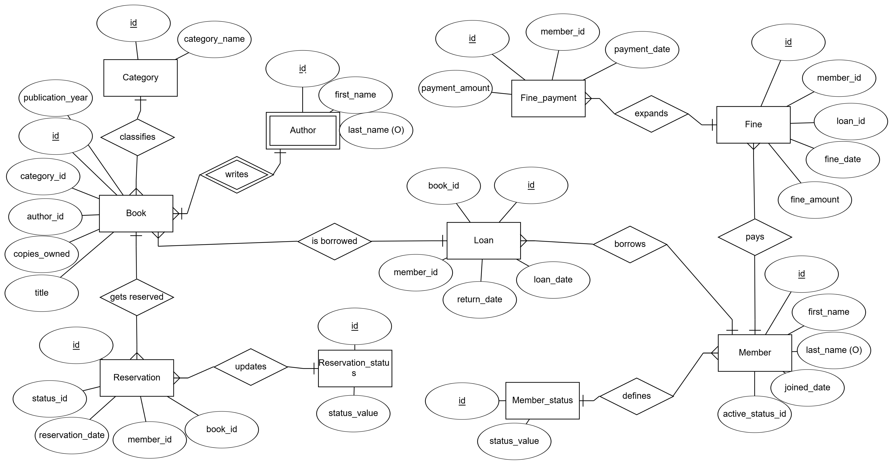
Notes:
10 Tricky Fundamental Questions on Relationships in a Database (Viva)
1. What is the difference between an identifying and a non-identifying relationship?
Answer:
Identifying Relationship: The child entity cannot exist without the parent, and the parent's primary key is part of the child’s primary key (e.g., Loan depends on Member).
Non-Identifying Relationship: The child entity can exist independently, and the foreign key is not part of the primary key (e.g., Member and Member Status).
2. Why is the book_id in the loan table a foreign key but not part of its primary key?
Answer:
Because a loan must refer to an existing book (one-to-many relationship), but a loan entry itself is uniquely identified by its own id, not by the book_id.
3. Can an entity have a foreign key that references multiple tables?
Answer:
No, a foreign key must reference one specific table, but a table can have multiple foreign keys referencing different tables.
4. What happens if a foreign key constraint is violated during insertion?
Answer:
The insertion fails because the referenced primary key must exist in the parent table first to maintain referential integrity.
5. Why do we use ON DELETE CASCADE and ON DELETE SET NULL?
Answer:
ON DELETE CASCADE: If the parent record is deleted, all child records are also deleted (e.g., deleting a book deletes its loans).
ON DELETE SET NULL: If the parent record is deleted, the child record's foreign key is set to NULL (e.g., if a member_status is deleted, members keep existing but lose their status).
6. Can we have a many-to-many relationship without a junction table?
Answer:
No, because relational databases do not support direct many-to-many relationships.
We need a junction table (like Book_Author) to store the relationships properly.
7. What is the difference between a foreign key and a primary key in terms of relationships?
Answer:
Primary Key: Uniquely identifies a record within a table.
Foreign Key: Refers to a primary key in another table to establish a relationship.
8. How does normalization affect relationships in a database?
Answer:
Normalization eliminates redundancy by ensuring proper one-to-many and many-to-many relationships.
It removes duplicate data and prevents anomalies in insertion, deletion, and updating.
9. Why is the author table considered a weak entity in your schema?
Answer:
Because an author cannot exist without at least one book.
The relationship is identifying (blue line) because the existence of an author depends on the book table.
10. Can a table have two foreign keys referencing the same parent table? Give an example.
Answer:
Yes! A table can have multiple foreign keys referring to the same table.
Example: A loan table could have two foreign keys, issued_by and approved_by, both referencing the librarian table.
Would you like more advanced questions or scenario-based tricky ones? 🚀

Slide 6
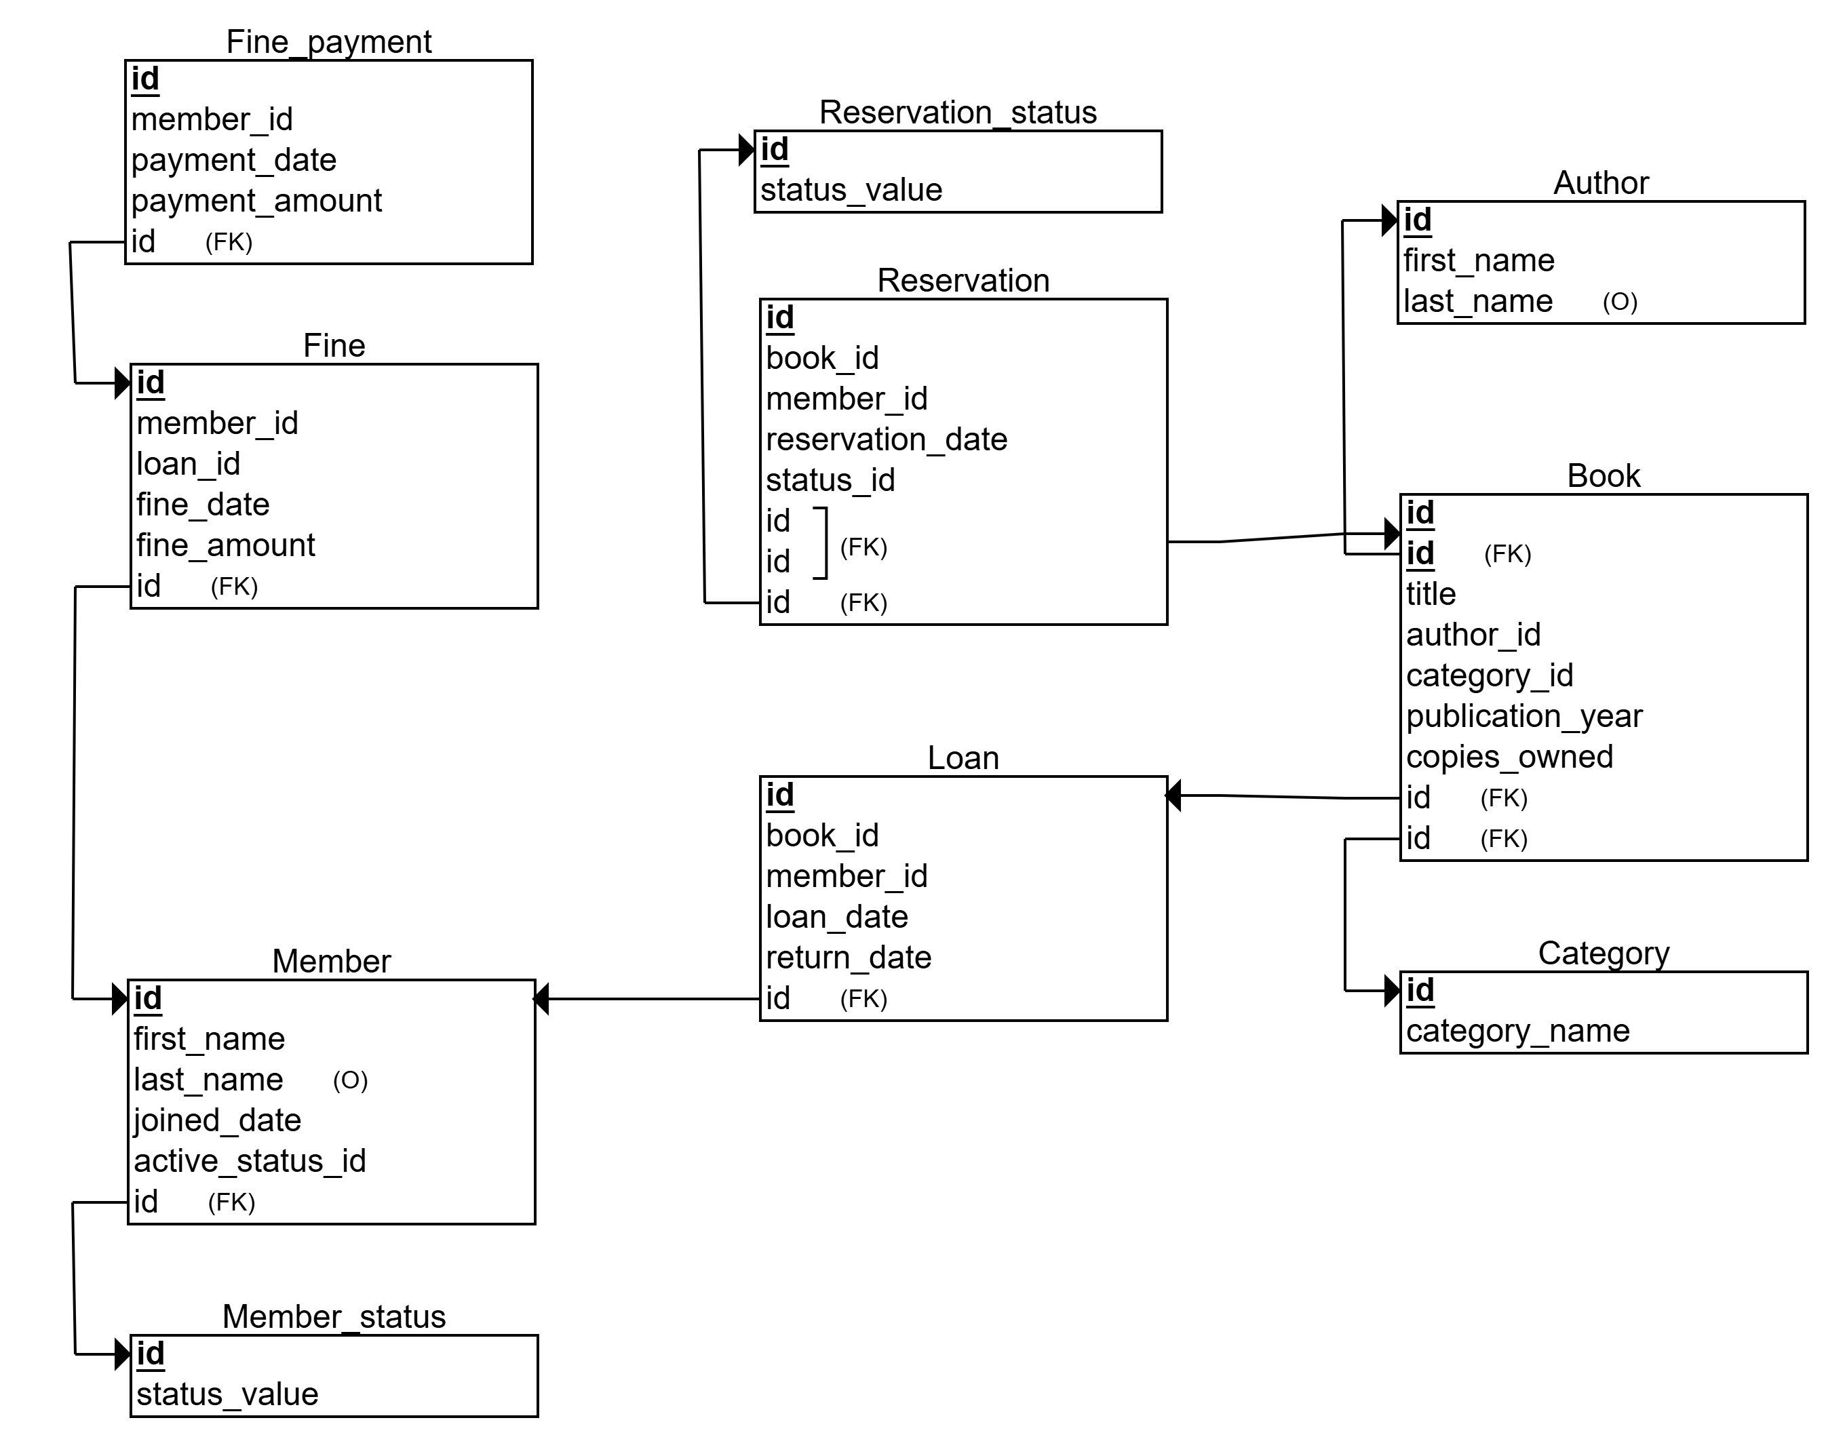
Relational Schema

Slide 7
Features
Author table is a weak entity, dependent on Book table as books can exist without authors (e.g. – Panchatantra etc.) but an author cannot exist without a book
Last names for members and authors is optional
Data constraints for integrity - CHECK constraints prevent invalid data entries (e.g., publication_year >= 1500, copies_owned >= 1).
Cascading for referential integrity (update and delete)
Inconsistent Loan data prevented by CHECK (loan_date <= returned_date) – prevents loans from being marked as returned before being issued
Multiple one-many relationships are used intentionally instead of multiple tables/values as:
Reduced redundancy,
Easy modification of data (ACID),
Easier cascading of operations
Simplified data retrieval (for this case; not useful for large number of tables)
Notes:
Flexibility – The system allows entities to exist without forcing immediate relationships. ✔ Realistic Data Representation – Not all members take loans, not all books are borrowed, and not all authors are tied to books. ✔ Avoiding Unnecessary Constraints – Making all relations mandatory would mean forcing data entry even when no meaningful relationship exists.

Slide 8
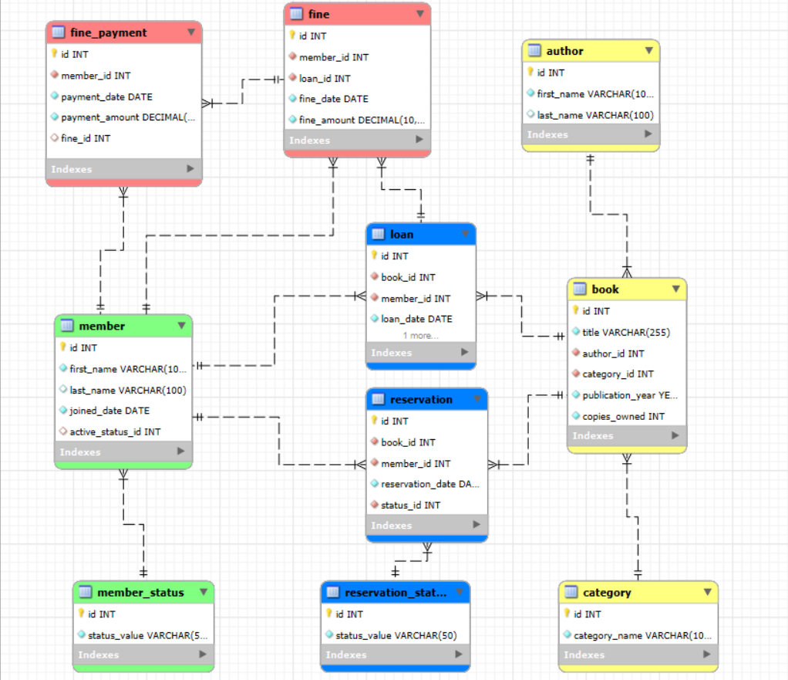
EER Diagram for Library Management
Tables displayed with data types, relations (primary and foreign key indexes)
Tables colour-coded per theme/category – member-related, borrowing-related, book-related, fine-related
One-many relationships displayed with better detail
Notes:
Black Lines → Regular Relationships (One-to-One or One-to-Many)
Standard foreign key connections.
Blue Lines → Identifying Relationships (Weak Entities)
Child entity depends on the parent for identification.
Parent's primary key is part of the child's primary key.
Red/Brown Lines → Non-Identifying Relationships (Optional Foreign Key)
Child entity can exist independently of the parent.
Used when foreign key is NOT part of the primary key.
Cyan/Light Blue Lines → Generalization/Specialization (ISA Hierarchy)
Represents inheritance in EER diagrams.
Dotted vs. Solid Lines
Solid Line → Mandatory Relationship (Foreign key cannot be NULL).
Dotted Line → Optional Relationship (Foreign key can be NULL or for specialization).

Slide 9
Understanding EER connections
1. Blue Line – Identifying Relationship
Represents a strong dependency where the child cannot exist without the parent.
The child’s primary key includes the parent’s primary key.
Examples in your EER diagram:
Author → Book (An author must be linked to at least one book)
Loan → Book (A loan must always reference a book)
2. Red/Brown Line – Non-Identifying Relationship
Represents a weak dependency, where the child can exist without the parent but references it using a foreign key.
The child’s primary key does not include the parent’s primary key.
Examples in your EER diagram:
Loan → Member (A member can exist without borrowing books)
Fine → Member (A member may exist without receiving a fine)
3. Cyan Line – Optional Relationship
Represents an optional relationship where the foreign key can be NULL.
The relationship is not mandatory.
Examples in your EER diagram:
Member → Member Status (A member may not have a status assigned yet)
Fine Payment → Fine (A fine may not have been paid yet)
4. Solid vs. Dotted Lines
Solid Line → Mandatory relationship (the relationship must always exist).
Dotted Line → Optional relationship (foreign key can be NULL).

Slide 10
Normalization (2F, 3F, BCNF)
The database follows normalization principles to ensure it remains clean, organized and efficient
It has no partial dependencies (2F compliance) – each column depends fully on the table’s primary key. For example, in the Loan table, loan details depend on both book and member, so they’re stored in separate tables
There are no transitive dependencies (3F compliance) – data is linked properly to avoid repetition (e.g. – category table instead of category names)
There is no redundant data (BCNF compliance) – due to interconnected primary keys in each table, no extra or duplicate information is stored unnecessarily. This also saves storage space
Referential integrity is maintained by proper CRUD (UD) operations – ON UPDATE CASCADE and ON UPDATE DELETE commands prevent orphaned records and keep tables in sync

Slide 11
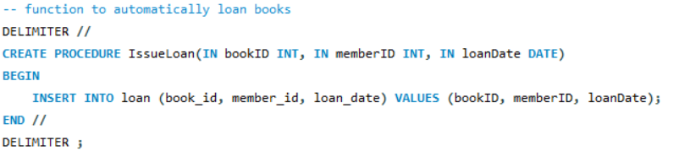
Queries & Procedures
Procedure to issue loans whenever book is borrowed
Some queries that can help functioning:
Find All Books Currently Loaned by a Member
Find Members Who Have Overdue Books
Calculate Total Fines for a Member's Loan History
Get All Active Reservations for a Book
Combined with these queries, the database servers as a fully functioning database system for a small-medium sized library

Slide 12
Thank you!
Doubts and queries – m2022bsass005@stud.tiss.edu

